Slide 1
Chapter 06
Dynamic Programming

Slide 2
Chapter 06_06 Dynamic Programming The Knapsack Problem and Memory Function

Slide 3
Chapter 06-06 Dynamic Programming Knapsack Problem
Given
n items of known weights w_{i} with values v_{i},
(w₁, v₁) (w₂, v₂), …, (w_{n}, v_{n})
a knapsack of capacity holding maximum weight W,
find the most valuable subset of the items that fit into the knapsack.
Equivalently, a transport plan that has to deliver the most valuable set of items to a remote location without exceeding the plan’s capacity.

Slide 4
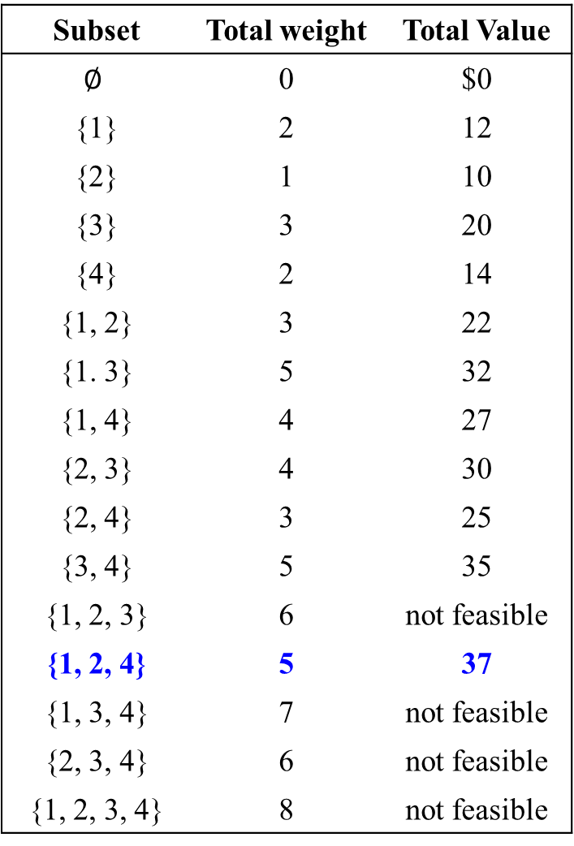
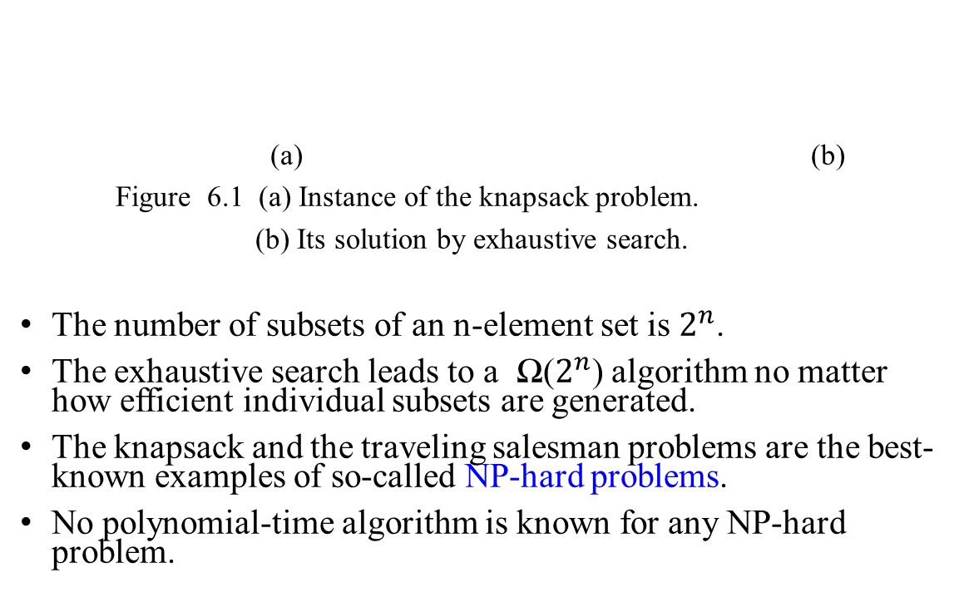
Knapsack Problem: The exhaustive search approach
Subset | Total weight | Total Value
$$∅$$ | 0 | $0
{1} | 2 | 12
{2} | 1 | 10
{3} | 3 | 20
{4} | 2 | 14
{1, 2} | 3 | 22
{1. 3} | 5 | 32
{1, 4} | 4 | 27
{2, 3} | 4 | 30
{2, 4} | 3 | 25
{3, 4} | 5 | 35
{1, 2, 3} | 6 | not feasible
{1, 2, 4} | 5 | 37
{1, 3, 4} | 7 | not feasible
{2, 3, 4} | 6 | not feasible
{1, 2, 3, 4} | 8 | not feasible
item | weight | value
1 | 2 | $ 12
2 | 1 | $ 10
3 | 3 | $ 20
4 | 2 | $ 15
Knapsack Capacity W = 5
(a) (b)
Figure 6.1 (a) Instance of the knapsack problem.
(b) Its solution by exhaustive search.
The number of subsets of an n-element set is $2^{n}$.
The exhaustive search leads to a Ω($2^{n}$) algorithm no matter how efficient individual subsets are generated.
The knapsack and the traveling salesman problems are the best-known examples of so-called NP-hard problems.
No polynomial-time algorithm is known for any NP-hard problem.

Slide 5

The Knapsack Problem and Memory Functions
Design a dynamic programming algorithm for the knapsack problem:
Given
n items of known weights w_{i} with values v_{i},
(w₁, v₁) (w₂, v₂), …, (w_{n}, v_{n})
a knapsack of capacity holding maximum weight W,
find the most valuable subset of the items that fit into the knapsack.
Assume that
item weights and the knapsack capacity are positive integers;
item values do not have to be integers.
Derive a recurrence relation that expresses
a solution to an instance of the knapsack problem in terms of solutions to its smaller sub-instances.

Slide 6
Consider an instance defined by the first i items, 1 ≤ i ≤ n, with
weights w₁ , w₂ , …, w_{i} ,
values v₁ , v₂ , …, v_{i} , and
knapsack capacity j, for 1 ≤ j ≤ W.
Let F(i, j) be the value of an optimal solution to this instance, i.e.,
the value of the most valuable subset of the first i items that fit into the knapsack of capacity j.
The goal is to find F(n, W),
the maximal value of a subset of the n given items that fit into the knapsack of capacity W, and
an optimal subset itself.

Slide 7
F(i, j) = Max{ F( i – 1, j), v_{i} + F( i -1, j - w_{i} ) } if j - w_{i} ≥ 0. (2)
or F(i, j) = F(i -1, j), if j - w_{i} < 0. (1)
Divide all the subsets of the first i items that fit the knapsack of capacity j into two categories:
1. Those that do not include the i^{th} item:
Among the subsets that do not include the i^{th} item, the value of an optimal subset is F(i -1, j), by definition.
2 Those that do include the i^{th} item
Among the subsets that do include the i^{th} item, say v_{i} having weight w_{i}, the value of such an optimal subset is v_{i} + F(i -1, j - w_{i}), where
the value F(i -1, j - w_{i}) is an optimal subset of the first i -1 items that fits into the knapsack of capacity j - w_{i} ≥ 0.

Slide 8
In (1.), if the i^{th} item does not fit into the knapsack, the value of an optimal subset selected from the first i items is the same as the value F( i – 1, j) of an optimal subset selected from the first i – 1 items.
In (2.), v_{i} + F(i -1, j - w_{i}) is the value of an optimal solution among all feasible subsets of the first i items.
These observations lead to the following recurrence:
with the knapsack has the capacity j, and from first i items,
Max{ F( i – 1, j), v_{i} + F( i -1, j - w_{i} ) } if j - w_{i} ≥ 0.
F(i , j) =
F(i -1, j) if j - w_{i} < 0. ….. 8.6
Adding the i^{th} item with weight , the total weight exceeds j.
For the inclusion of the i^{th} item (v_{i}, w_{i} ), “j - w_{i} ≥ 0” means that j ≥ w_{i} and therefore adding the i^{th} item with weight w_{i} , the total weight is not exceeded the capacity j.
If “j - w_{i} < 0.” means j < w_{i} . Adding the i^{th} item with weight w_{i} , the total weight exceeds the capacity j .

Slide 9
This conclude:
Max{F( i – 1, j), v_{i} + F( i -1, j - w_{i} ) } if j - w_{i} ≥ 0;
F(i , j) =
F(i -1, j), if j - w_{i} < 0 ….. 8.6
with the initial conditions which are as follows:
F(0, j) = 0 for j ≥ 0 and F(i , 0) = 0 for i ≥ 0. …. 8.7
The goal is to find F(n, W), the maximal value of a subset of the n given items that fit into the knapsack of capacity W, and an optimal subset itself.

Slide 10
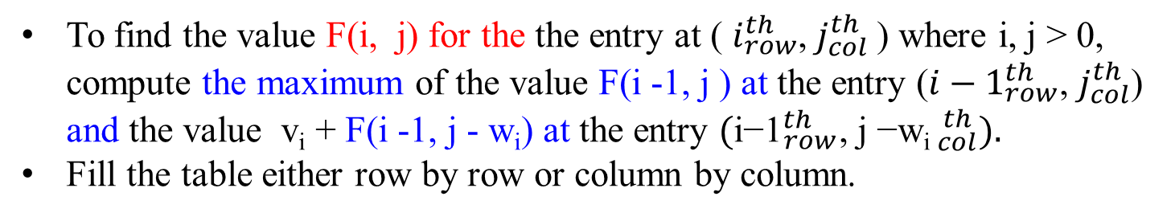
F(i, j) = Max{ F( i – 1, j), v_{i} + F( i -1, j - w_{i} ) } if j - w_{i} ≥ 0.
F(i -1, j), if j - w_{i} < 0
To find the value F(i, j) for the the entry at ( $i_{row}^{th}$, $j_{col}^{th}$) where i, j > 0, compute the maximum of the value F(i -1, j ) at the entry (${i−1}_{row}^{th}$, $j_{col}^{th}$) and the value v_{i} + F(i -1, j - w_{i}) at the entry ${(\text{i}\text{−1}}_{row}^{th}$, ${\text{j}\text{ −}\text{wi} }_{col}^{ th}).$
Fill the table either row by row or column by column.
 | i / j | 0 | … | j - w_{i} | … | j | W
w₀, v₀ | 0 | 0 |  | 0 |  | 0 | 0
w_{j-1}， v_{i-1} | i - 1 | 0 |  | F(i -1, j - w_{i}) |  | F(i -1, j )
w_{j}, v_{i} | i | 0 |  |  |  | F(i , j )
w_{n}, v_{n} | n | 0 |  |  |  |  | goal
Figure 8.4 Table for solving the knapsack problem by dynamic programming.

Slide 11
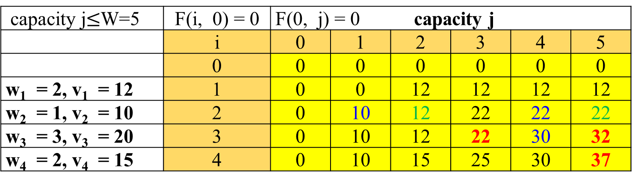
Example 1. Given the instance data: The Knapsack’s capacity W = 5.
item | weight | value
1 | 2 | $ 12
2 | 1 | $ 10
3 | 3 | $ 20
4 | 2 | $ 15
Max{ F( i – 1, j), v_{i} + F( i -1, j - w_{i} ) },
F(i, j) = if j - w_{i} ≥ 0. …(8.6)
F(i -1, j), if j - w_{i} < 0. …(8.7)
Figure 8.5. The dynamic programming table, filled by applying formulas (8.6) and (8.7), is shown below.
capacity j$≤$W=5 | F(i, 0) = 0 | F(0, j) = 0 capacity j
 | i | 0 | 1 | 2 | 3 | 4 | 5
 | 0 | 0 | 0 | 0 | 0 | 0 | 0
w₁ = 2, v₁ = 12 | 1 | 0 | 0 | 12 | 12 | 12 | 12
w₂ = 1, v₂ = 10 | 2 | 0 | 10 | 12 | 22 | 22 | 22
w₃ = 3, v₃ = 20 | 3 | 0 | 10 | 12 | 22 | 30 | 32
w₄ = 2, v₄ = 15 | 4 | 0 | 10 | 15 | 25 | 30 | 37
F(4, 5) = Max{ F(3, 5), v₄ + F(3, 5 – 2) } = Max {32 , 15 + 22} = Max{32, 37} = 37.

Slide 12
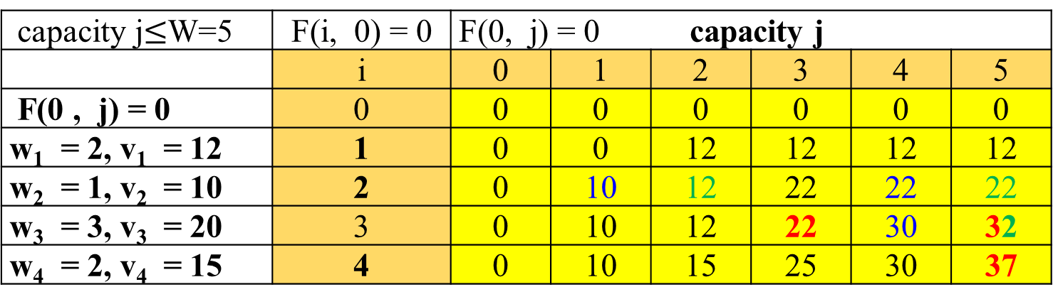
The Example 1 in Figure 8.5, the following dynamic programming table, filled by applying formulas (8.6) and (8.7)
capacity j$≤$W=5 | F(i, 0) = 0 | F(0, j) = 0 capacity j
 | i | 0 | 1 | 2 | 3 | 4 | 5
F(0 , j) = 0 | 0 | 0 | 0 | 0 | 0 | 0 | 0
w₁ = 2, v₁ = 12 | 1 | 0 | 0 | 12 | 12 | 12 | 12
w₂ = 1, v₂ = 10 | 2 | 0 | 10 | 12 | 22 | 22 | 22
w₃ = 3, v₃ = 20 | 3 | 0 | 10 | 12 | 22 | 30 | 32
w₄ = 2, v₄ = 15 | 4 | 0 | 10 | 15 | 25 | 30 | 37
The maximal value is 37, computed by F(4, 5) = Max{ F(3, 5), v₄ + F(3, 5 – 2)}
= Max {32 , 15 + 22}
= Max{32, 37}
= 37.
The composition of an optimal subset is {item 1, item 2, item 4}. (How to find it?)
The time efficiency and space efficiency of this algorithm are both in ϴ( n*W ).
The time needed to find the composition of an optimal solution is in O( n + W ).

Slide 13
The maximal value is F(4, 5) = 37.
Find the composition of an optimal subset, by tracing back the computations of this entry F(4, 5) in the table.
Since F(4, 5) > F(3, 5), item 4 (i.e., w₄ = 2, v₄ = 15) is included in an optimal solution along with an optimal subset for filling the remaining units, 5 – 2 = 3, of the knapsack capacity. The value of the latter is F(3, 3) = 22.
Since F(3, 3) = F(2, 3) = 22 , item 3 (i.e., w₃ = 3, v₃ = 20) is not included in an optimal subset.
Since F(2, 3) > F(1, 3), item 2 (i.e., w₁ = 2, v₁ = 12) is a part of an optimal selection, which leaves element F(1, 3-1) for filling its remaining units 3-1= 2. The value of the latter is F(1, 2) = 12.
Similarly, since F(1, 2) > F(0, 2), item 1 (i.e., w₁ = 2, v₁ = 12) is the final part of the optimal solution {item 1, item 2, item 4}.
(The next two viewgraphs demonstrate the above.)

Slide 14
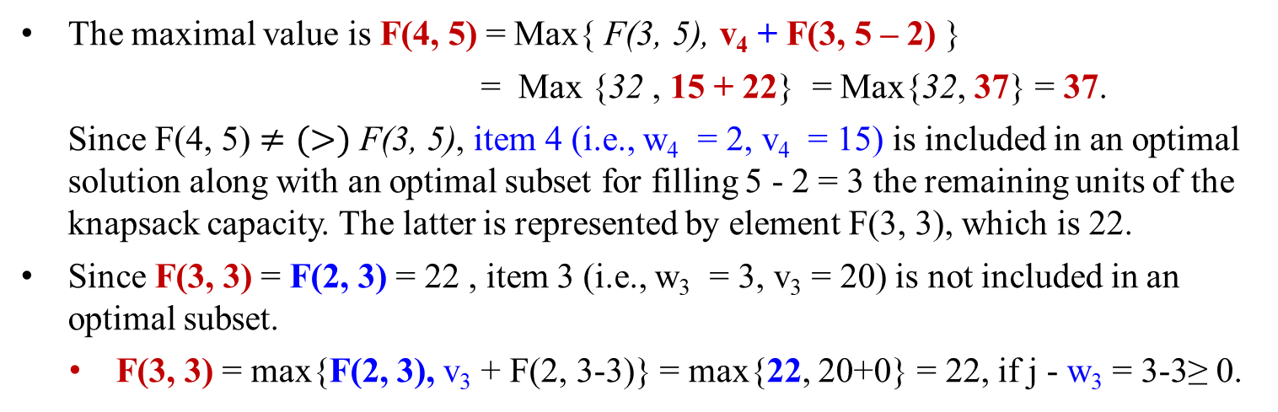
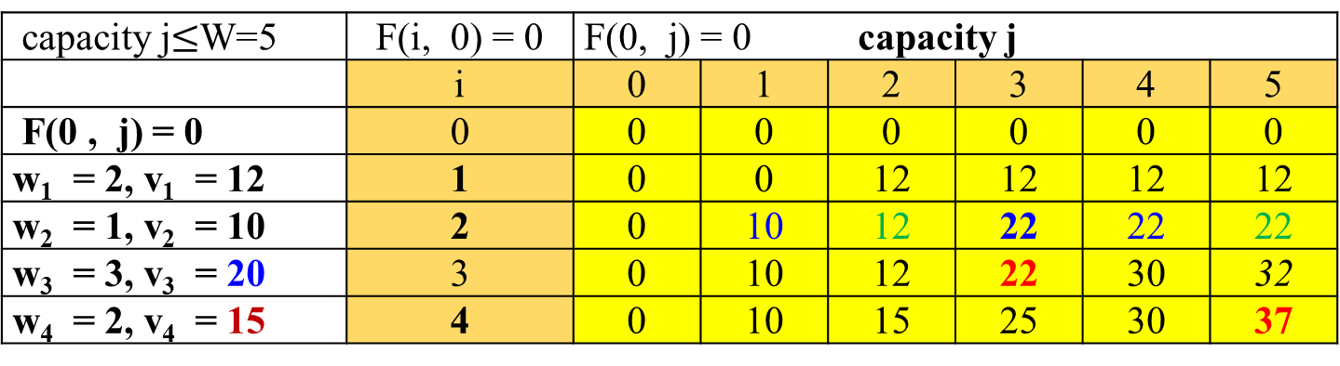
Find the composition of an optimal subset by tracing back the computation of this entry F(4, 5) in the table.
F(i, j) = Max{ F( i - 1, j), v_{i} + F( i -1, j - w_{i} ) } if j - w_{i} ≥ 0.
F( i - 1, j), if j - w_{i} < 0.
capacity j$≤$W=5 | F(i, 0) = 0 | F(0, j) = 0 capacity j
 | i | 0 | 1 | 2 | 3 | 4 | 5
F(0 , j) = 0 | 0 | 0 | 0 | 0 | 0 | 0 | 0
w₁ = 2, v₁ = 12 | 1 | 0 | 0 | 12 | 12 | 12 | 12
w₂ = 1, v₂ = 10 | 2 | 0 | 10 | 12 | 22 | 22 | 22
w₃ = 3, v₃ = 20 | 3 | 0 | 10 | 12 | 22 | 30 | 32
w₄ = 2, v₄ = 15 | 4 | 0 | 10 | 15 | 25 | 30 | 37
The maximal value is F(4, 5) = Max{ F(3, 5), v₄ + F(3, 5 – 2) }
= Max {32 , 15 + 22} = Max{32, 37} = 37.
Since F(4, 5) $≠(>)$ F(3, 5), item 4 (i.e., w₄ = 2, v₄ = 15) is included in an optimal solution along with an optimal subset for filling 5 - 2 = 3 the remaining units of the knapsack capacity. The latter is represented by element F(3, 3), which is 22.
Since F(3, 3) = F(2, 3) = 22 , item 3 (i.e., w₃ = 3, v₃ = 20) is not included in an optimal subset.
F(3, 3) = max{F(2, 3), v₃ + F(2, 3-3)} = max{22, 20+0} = 22, if j - w₃ = 3-3≥ 0.

Slide 15
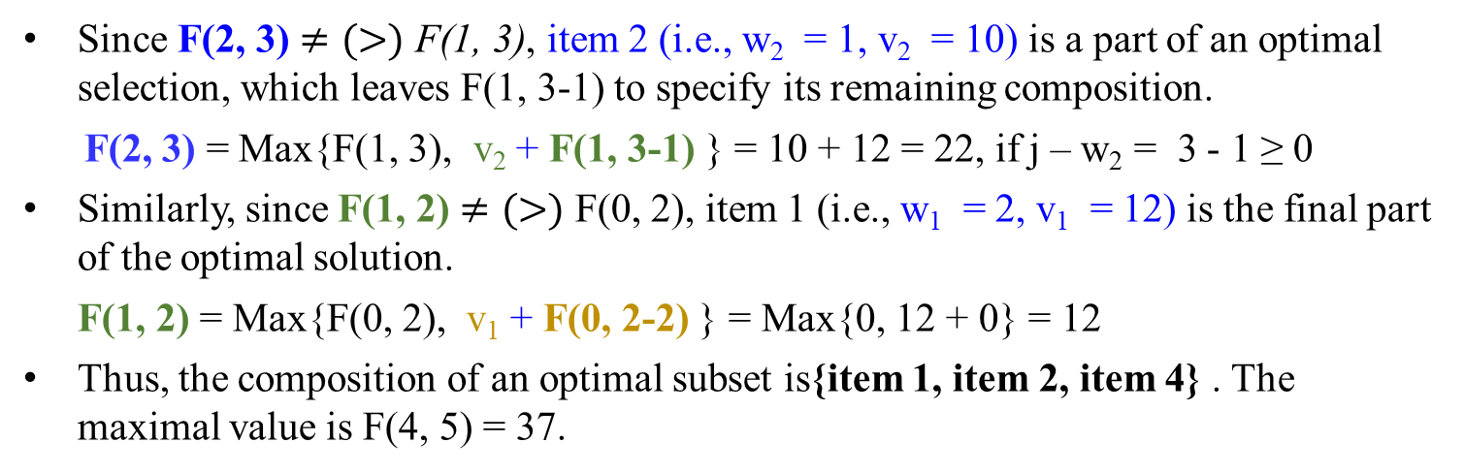
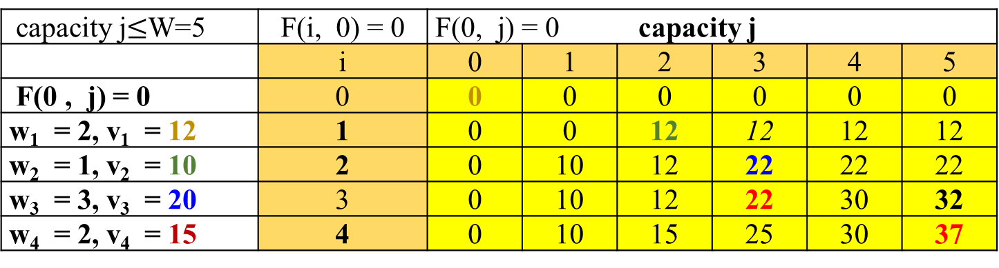
Find the composition of an optimal subset by tracing back the computation of this entry F(4, 5) in the table.
F(i, j) = Max{ F( i - 1, j), v_{i} + F( i -1, j - w_{i} ) } if j - w_{i} ≥ 0.
F( i - 1, j), if j - w_{i} < 0.
capacity j$≤$W=5 | F(i, 0) = 0 | F(0, j) = 0 capacity j
 | i | 0 | 1 | 2 | 3 | 4 | 5
F(0 , j) = 0 | 0 | 0 | 0 | 0 | 0 | 0 | 0
w₁ = 2, v₁ = 12 | 1 | 0 | 0 | 12 | 12 | 12 | 12
w₂ = 1, v₂ = 10 | 2 | 0 | 10 | 12 | 22 | 22 | 22
w₃ = 3, v₃ = 20 | 3 | 0 | 10 | 12 | 22 | 30 | 32
w₄ = 2, v₄ = 15 | 4 | 0 | 10 | 15 | 25 | 30 | 37
Since F(2, 3) $≠(>)$ F(1, 3), item 2 (i.e., w₂ = 1, v₂ = 10) is a part of an optimal selection, which leaves F(1, 3-1) to specify its remaining composition.
F(2, 3) = Max{F(1, 3), v₂ + F(1, 3-1) } = 10 + 12 = 22, if j – w₂ = 3 - 1 ≥ 0
Similarly, since F(1, 2) $≠(>)$ F(0, 2), item 1 (i.e., w₁ = 2, v₁ = 12) is the final part of the optimal solution.
F(1, 2) = Max{F(0, 2), v₁ + F(0, 2-2) } = Max{0, 12 + 0} = 12
Thus, the composition of an optimal subset is{item 1, item 2, item 4} . The maximal value is F(4, 5) = 37.

Slide 16
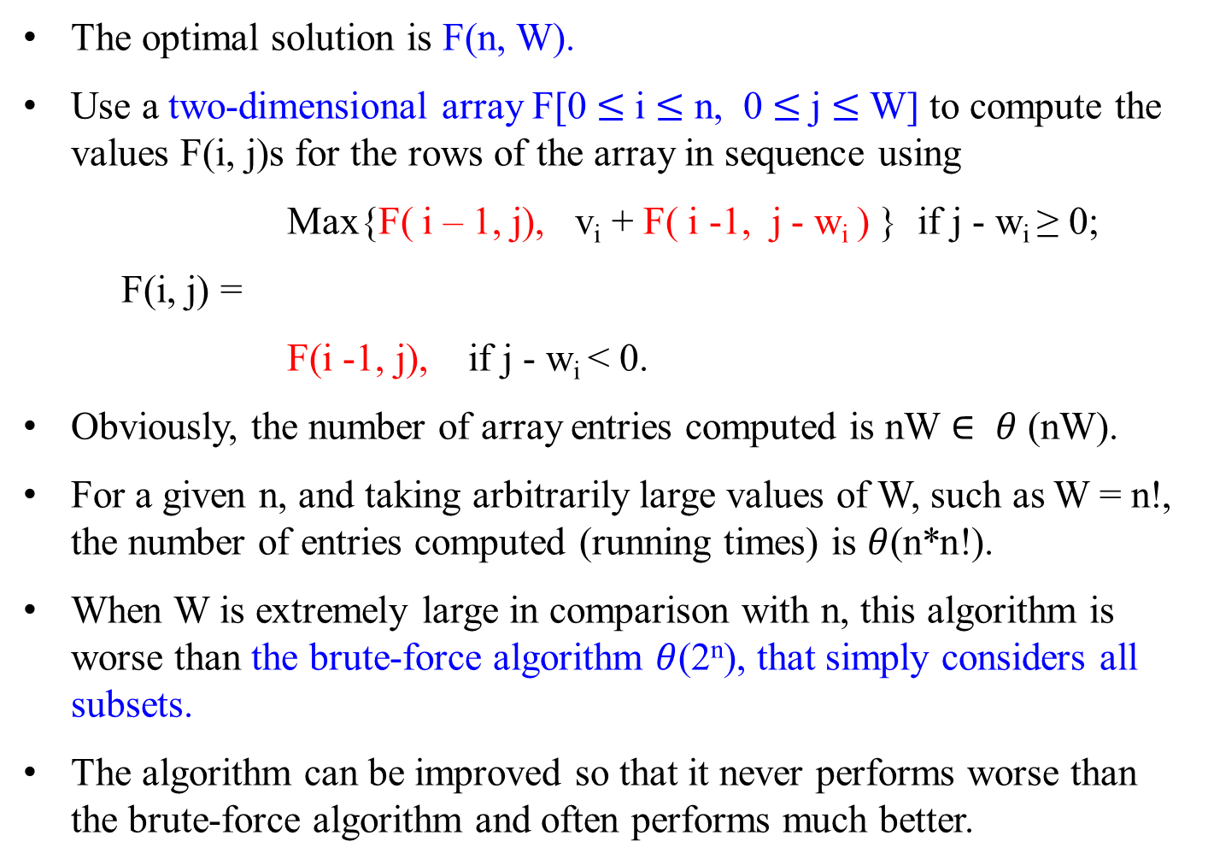
The optimal solution is F(n, W).
Use a two-dimensional array F[0 $≤$i $≤$ n, 0 $≤$j $≤$ W] to compute the values F(i, j)s for the rows of the array in sequence using
Max{F( i – 1, j), v_{i} + F( i -1, j - w_{i} ) } if j - w_{i} ≥ 0;
F(i, j) =
F(i -1, j), if j - w_{i} < 0.
Obviously, the number of array entries computed is nW $∈ θ$ (nW).
For a given n, and taking arbitrarily large values of W, such as W = n!, the number of entries computed (running times) is $θ$(n*n!).
When W is extremely large in comparison with n, this algorithm is worse than the brute-force algorithm $θ$(2^{n}), that simply considers all subsets.
The algorithm can be improved so that it never performs worse than the brute-force algorithm and often performs much better.
Adding the i^{th} item with weight w_{i} , the total weight exceeds j.

Slide 17
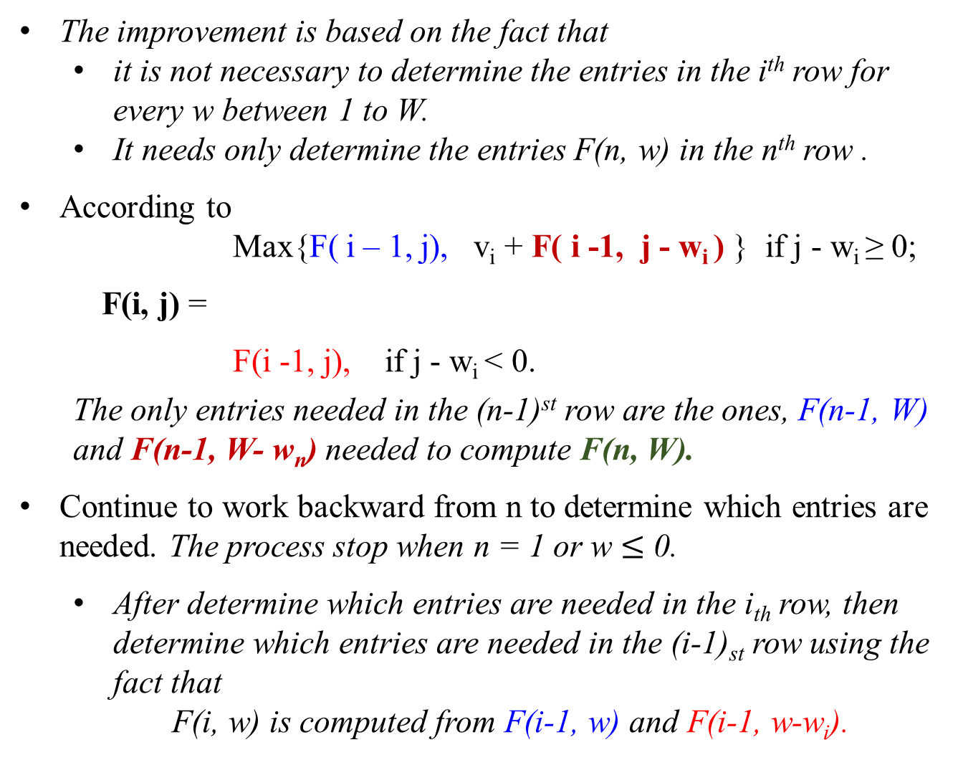
The improvement is based on the fact that
it is not necessary to determine the entries in the i^{th} row for every w between 1 to W.
It needs only determine the entries F(n, w) in the n^{th} row .
According to
Max{F( i – 1, j), v_{i} + F( i -1, j - w_{i} ) } if j - w_{i} ≥ 0;
F(i, j) =
F(i -1, j), if j - w_{i} < 0.
The only entries needed in the (n-1)^{st} row are the ones, F(n-1, W) and F(n-1, W- w_{n}) needed to compute F(n, W).
Continue to work backward from n to determine which entries are needed. The process stop when n = 1 or w $≤$ 0.
After determine which entries are needed in the i_{th} row, then determine which entries are needed in the (i-1)_{st} row using the fact that
F(i, w) is computed from F(i-1, w) and F(i-1, w-w_{i}).

Slide 18
Chapter 06-06 Dynamic Programming
The Knapsack Problem and Memory Functions

Slide 19
The following algorithm implements this idea for the knapsack problem. After initializing the table, the recursive function needs to be called with i = n (the number of items) and j = W (the knapsack capacity).

Slide 20
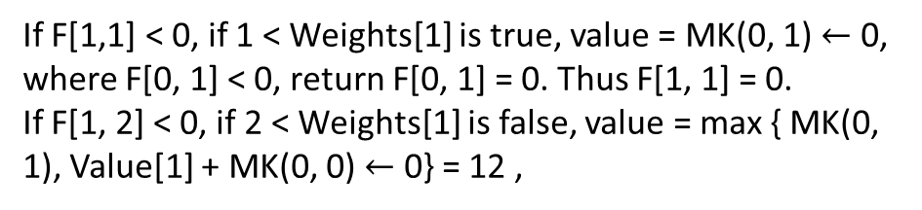
F(i, j) = Max{ F( i - 1, j), v_{i} + F( i -1, j - w_{i} ) } if j - w_{i} ≥ 0.
F( i - 1, j), if j - w_{i} < 0.
Algorithm MFKnapsack(i, j)
//Implements the memory function method for the knapsack problem
Input: A nonnegative integer i indicating the number of the first items
being considered and a nonnegative integer j indicating the
knapsack capacity.
Output: The value of an optimal feasible subset of the first i items
//Note : Uses as global variables input arrays Weights[1 .. n], Values[1 .. n],
// and table F[0 .. n, 0 .. W] whose entries are initialize with -1’s except
// for row 0 and column 0 initialized with 0’s
if F[i, j] < 0 {
if j < Weights[ i ]
value ← MFKnapsack(i -1, j)
else
value ← max{ MFKnapsack(i -1, j),
Value[ i ] + MFKnapsack(i -1, j – Weights[ i ]) };
F[i, j] ← value; }
return F[i, j];
initialization | capacity j
 | i | 0 | 1 | 2 | 3 | 4 | 5
 | 0 | 0 | 0 | 0 | 0 | 0 | 0
w₁ =2, v₁ = 12 | 1 | 0 | -1 | -1 | -1 | -1 | -1
w₂ =1, v₂ = 10 | 2 | 0 | -1 | -1 | -1 | -1 | -1
w₃ =3, v₃ = 20 | 3 | 0 | -1 | -1 | -1 | -1 | -1
w₄ =2, v₄ = 15 | 4 | 0 | -1 | -1 | -1 | -1 | -1
If F[1,1] < 0, if 1 < Weights[1] is true, value = MK(0, 1) $←$ 0, where F[0, 1] < 0, return F[0, 1] = 0. Thus F[1, 1] = 0.
If F[1, 2] < 0, if 2 < Weights[1] is false, value = max { MK(0, 1), Value[1] + MK(0, 0) $←$ 0} = 12 ,

Slide 21


F(i, j) = Max{ F( i - 1, j), v_{i} + F( i -1, j - w_{i} ) } if j - w_{i} ≥ 0.
F( i - 1, j), if j - w_{i} < 0.
Algorithm MFKnapsack(i, j)
if F[i, j] < 0 {
if j < Weights[ i ]
value ← MFKnapsack(i -1, j)
else
value ← max{ MFKnapsack(i -1, j),
Value[ i ] + MFKnapsack(i -1, j – Weights[ i ]) };
F[i, j] ← value; }
return F[i, j];
initialization | capacity j
 | i | 0 | 1 | 2 | 3 | 4 | 5
 | 0 | 0 | 0 | 0 | 0 | 0 | 0
w₁ =2, v₁ = 12 | 1 | 0 | -1 | -1 | -1 | -1 | -1₃
w₂ =1, v₂ = 10 | 2 | 0 | -1 | -1 | -1 | -1 | -1₂
w₃ =3, v₃ = 20 | 3 | 0 | -1 | -1 | -1 | -1 | -1₁
w₄ =2, v₄ = 15 | 4 | 0 | -1 | -1 | -1 | -1 | -1₀
======= oL2
MK(2, 5)
If F[2, 5] = -1 < 0
If 5 < W[2]=1 $→$ f
Else v ← max{MK(1, 5), V[2] + MK[1, 5-W[2] = 5-1=4]}
………….oL3
MK(1, 5)
If F[1, 5] = -1 < 0
If 5 < W[1]=2 $→$ f
Else v ← max{MK(0, 5), V[1] + MK[0, 5-W[1] = 5-2=3]}
**********oL4
MK(0, 5){if F[0,5]=0 < 0 $→$ f, then return F[0, 5] = 0}
**********cL4
F[1, 5] ← v
Return F[1, 5]
………….cL3
F[2, 5] ← v
Return F[2, 5]
======= cL2
-------------oL0
MK(4, 5)
If F[4, 5] = -1 < 0
If 5 < W[4] = 2 $→$ f
Else v ← max{MK(3, 5), V[4] + MK[3, 5-W[4] = 5-2=3]}
++++++oL1
MK(3, 5)
If F[3, 5] = -1 < 0
If 5 < W[3]=2 $→$ f
Else v ← max{MK(2, 5), V[3] + MK[2, 5-W[3] = 5-3=2]}
======= oL2
MK(2, 5)
======= cL2
F[3, 5] ← v
Return F[3, 5]
+++++ cL1
F[4, 5] ← v
Return F[4, 5]
-----------cL0

Slide 22



F(i, j) = Max{ F( i - 1, j), v_{i} + F( i -1, j - w_{i} ) } if j - w_{i} ≥ 0.
F( i - 1, j), if j - w_{i} < 0.
Algorithm MFKnapsack(i, j)
if F[i, j] < 0 {
if j < Weights[ i ]
value ← MFKnapsack(i -1, j)
else
value ← max{ MFKnapsack(i -1, j),
Value[ i ] + MFKnapsack(i -1, j – Weights[ i ]) };
F[i, j] ← value; }
return F[i, j];
initialization | capacity j
 | i | 0 | 1 | 2 | 3 | 4 | 5
 | 0 | 0 | 0 | 0 | 0 | 0 | 0
w₁ =2, v₁ = 12 | 1 | 0 | -1 | -1 | -1 | -1 | 12₃
w₂ =1, v₂ = 10 | 2 | 0 | -1 | -1 | -1 | -1 | -1₂
w₃ =3, v₃ = 20 | 3 | 0 | -1 | -1 | -1 | -1 | -1₁
w₄ =2, v₄ = 15 | 4 | 0 | -1 | -1 | -1 | -1 | -1₀
======= oL2
MK(2, 5)
If F[2, 5] = -1 < 0
If 5 < W[2]=1 $→$ f
Else v ← max{MK(1, 5), V[2] + MK[1, 5-W[2] = 5-1=4]}
………….oL3
MK(1, 5)
If F[1, 5] = -1 < 0
If 5 < W[1]=2 $→$ f
Else v ← max{MK(0, 5), V[1] + MK[0, 5-W[1] = 5-2=3]}
← max{0, V[1]=12 + MK[0, 5-W[1] = 5-2=3]}
← max{0, V[1]=12 + MK[0, 3] = 0}
← 12
**********oL4
MK(0, 5){if F[0,5]=0 < 0 $→$ f, then return F[0, 5] = 0}
**********cL4
**********oL4
Mk(0, 3) {if F[0,3] = 0 < 0 $→$ f, then return F[0, 3] = 0 }
**********cL4
F[1, 5] ← v = 12
Return F[1, 5] = 12
………….cL3
F[2, 5] ← v
Return F[2, 5]
======= cL2
======= oL2
MK(2, 5)
If F[2, 5] = -1 < 0
If 5 < W[2]=1 $→$ f
Else v ← max{MK(1, 5), V[2] + MK[1, 5-W[2] = 5-1=4]}
………….oL3
MK(1, 5)
If F[1, 5] = -1 < 0
If 5 < W[1]=2 $→$ f
Else v ← max{MK(0, 5), V[1] + MK[0, 5-W[1] = 5-2=3]}
**********oL4
MK(0, 5){if F[0,5]=0 < 0 $→$ f, then return F[0, 5] = 0}
**********cL4
F[1, 5] ← v
Return F[1, 5]
………….cL3
F[2, 5] ← v
Return F[2, 5]
======= cL2
-------------oL0
MK(4, 5)
If F[4, 5] = -1 < 0
If 5 < W[4] = 2 $→$ f
Else v ← max{MK(3, 5), V[4] + MK[3, 5-W[4] = 5-2=3]}
++++++oL1
MK(3, 5)
If F[3, 5] = -1 < 0
If 5 < W[3]=2 $→$ f
Else v ← max{MK(2, 5), V[3] + MK[2, 5-W[3] = 5-3=2]}
======= oL2
MK(2, 5)
======= cL2
F[3, 5] ← v
Return F[3, 5]
+++++ cL1
F[4, 5] ← v
Return F[4, 5]
-----------cL0

Slide 23


F(i, j) = Max{ F( i - 1, j), v_{i} + F( i -1, j - w_{i} ) } if j - w_{i} ≥ 0.
F( i - 1, j), if j - w_{i} < 0.
Algorithm MFKnapsack(i, j)
if F[i, j] < 0 {
if j < Weights[ i ]
value ← MFKnapsack(i -1, j)
else
value ← max{ MFKnapsack(i -1, j),
Value[ i ] + MFKnapsack(i -1, j – Weights[ i ]) };
F[i, j] ← value; }
return F[i, j];
======= oL2
MK(2, 5)
If F[2, 5] = -1 < 0
If 5 < W[2]=1 $→$ f
Else v ← max{MK(1, 5), V[2] + MK(1, 5-W[2] = 5-1=4)}
← max{12, 10 + MK(1, 4)}
………….oL3
MK(1, 4)
If F[1, 4] = -1<0
If 4 < W[1]=2 $→$ f
Else v ← max{MK(0, 4), V[1] + MK(0, 4-W[1] = 5-2=3)}
← max{0, 12 + MK(0, 3)} ← 12
F[1, 4] ← 12
Return F[1, 4] =12
…………..cL3
………….oL3
MK(1, 5)
**********oL4
MK(0, 5){if F[0,5]=0 < 0 $→$ f, then return F[0, 5] = 0}
**********cL4
**********oL4
Mk(0, 3) {if F[0,3] = 0 < 0 $→$ f, then return F[0, 3] = 0 }
**********cL4
Return F[1, 5] = 12
………….cL3
F[2, 5] ← v
Return F[2, 5]
======= cL2
initialization | capacity j
 | i | 0 | 1 | 2 | 3 | 4 | 5
 | 0 | 0 | 0 | 0 | 0 | 0 | 0
w₁ =2, v₁ = 12 | 1 | 0 | -1 | -1 | -1 | 12₃ | 12₃
w₂ =1, v₂ = 10 | 2 | 0 | -1 | -1 | -1 | -1 | -1₂
w₃ =3, v₃ = 20 | 3 | 0 | -1 | -1 | -1 | -1 | -1₁
w₄ =2, v₄ = 15 | 4 | 0 | -1 | -1 | -1 | -1 | -1₀
======= oL2
MK(2, 5)
If F[2, 5] = -1 < 0
If 5 < W[2]=1 $→$ f
Else v ← max{MK(1, 5), V[2] + MK[1, 5-W[2] = 5-1=4]}
………….oL3
MK(1, 5)
If F[1, 5] = -1 < 0
If 5 < W[1]=2 $→$ f
Else v ← max{MK(0, 5), V[1] + MK[0, 5-W[1] = 5-2=3]}
**********oL4
MK(0, 5){if F[0,5]=0 < 0 $→$ f, then return F[0, 5] = 0}
**********cL4
F[1, 5] ← v
Return F[1, 5]
………….cL3
F[2, 5] ← v
Return F[2, 5]
======= cL2
-------------oL0
MK(4, 5)
If F[4, 5] = -1 < 0
If 5 < W[4] = 2 $→$ f
Else v ← max{MK(3, 5), V[4] + MK[3, 5-W[4] = 5-2=3]}
++++++oL1
MK(3, 5)
If F[3, 5] = -1 < 0
If 5 < W[3]=2 $→$ f
Else v ← max{MK(2, 5), V[3] + MK[2, 5-W[3] = 5-3=2]}
======= oL2
MK(2, 5)
======= cL2
F[3, 5] ← v
Return F[3, 5]
+++++ cL1
F[4, 5] ← v
Return F[4, 5]
-----------cL0

Slide 24


F(i, j) = Max{ F( i - 1, j), v_{i} + F( i -1, j - w_{i} ) } if j - w_{i} ≥ 0.
F( i - 1, j), if j - w_{i} < 0.
Algorithm MFKnapsack(i, j)
if F[i, j] < 0 {
if j < Weights[ i ]
value ← MFKnapsack(i -1, j)
else
value ← max{ MFKnapsack(i -1, j),
Value[ i ] + MFKnapsack(i -1, j – Weights[ i ]) };
F[i, j] ← value; }
return F[i, j];
initialization | capacity j
 | i | 0 | 1 | 2 | 3 | 4 | 5
 | 0 | 0 | 0 | 0 | 0 | 0 | 0
w₁ =2, v₁ = 12 | 1 | 0 | -1 | -1 | -1 | 12₃ | 12₃
w₂ =1, v₂ = 10 | 2 | 0 | -1 | -1 | -1 | -1 | 22₂
w₃ =3, v₃ = 20 | 3 | 0 | -1 | -1 | -1 | -1 | -1₁
w₄ =2, v₄ = 15 | 4 | 0 | -1 | -1 | -1 | -1 | -1₀
======= oL2
MK(2, 5)
If F[2, 5] = -1 < 0
If 5 < W[2]=1 $→$ f
Else v ← max{MK(1, 5), V[2] + MK(1, 5-W[2] = 5-1=4)}
← max{12, 10 + MK(1, 4)} ← max{, 12, 10+12 ← 22
………….oL3
MK(1, 4)
…
Return F[1, 4] =12
…………..cL3
………….oL3
MK(1, 5)
**********oL4
MK(0, 5){if F[0,5]=0 < 0 $→$ f, then return F[0, 5] = 0}
**********cL4
**********oL4
Mk(0, 3) {if F[0,3] = 0 < 0 $→$ f, then return F[0, 3] = 0 }
**********cL4
Return F[1, 5] = 12
………….cL3
F[2, 5] ← v ← 22
Return F[2, 5] = 22
======= cL2
======= oL2
MK(2, 5)
If F[2, 5] = -1 < 0
If 5 < W[2]=1 $→$ f
Else v ← max{MK(1, 5), V[2] + MK[1, 5-W[2] = 5-1=4]}
………….oL3
MK(1, 5)
If F[1, 5] = -1 < 0
If 5 < W[1]=2 $→$ f
Else v ← max{MK(0, 5), V[1] + MK[0, 5-W[1] = 5-2=3]}
**********oL4
MK(0, 5){if F[0,5]=0 < 0 $→$ f, then return F[0, 5] = 0}
**********cL4
F[1, 5] ← v
Return F[1, 5]
………….cL3
F[2, 5] ← v
Return F[2, 5]
======= cL2
-------------oL0
MK(4, 5)
If F[4, 5] = -1 < 0
If 5 < W[4] = 2 $→$ f
Else v ← max{MK(3, 5), V[4] + MK[3, 5-W[4] = 5-2=3]}
++++++oL1
MK(3, 5)
If F[3, 5] = -1 < 0
If 5 < W[3]=2 $→$ f
Else v ← max{MK(2, 5), V[3] + MK[2, 5-W[3] = 5-3=2]}
======= oL2
MK(2, 5) = 22
======= cL2
F[3, 5] ← v
Return F[3, 5]
+++++ cL1
F[4, 5] ← v
Return F[4, 5]
-----------cL0

Slide 25


F(i, j) = Max{ F( i - 1, j), v_{i} + F( i -1, j - w_{i} ) } if j - w_{i} ≥ 0.
F( i - 1, j), if j - w_{i} < 0.
Algorithm MFKnapsack(i, j)
if F[i, j] < 0 {
if j < Weights[ i ]
value ← MFKnapsack(i -1, j)
else
value ← max{ MFKnapsack(i -1, j),
Value[ i ] + MFKnapsack(i -1, j – Weights[ i ]) };
F[i, j] ← value; }
return F[i, j];
initialization | capacity j
 | i | 0 | 1 | 2 | 3 | 4 | 5
 | 0 | 0 | 0 | 0 | 0 | 0 | 0
w₁ =2, v₁ = 12 | 1 | 0 | -1₃ | 12₃ | -1 | 12₃ | 12₃
w₂ =1, v₂ = 10 | 2 | 0 | -1 | -1₂ | -1 | -1 | 22₂
w₃ =3, v₃ = 20 | 3 | 0 | -1 | -1 | -1 | -1 | -1₁
w₄ =2, v₄ = 15 | 4 | 0 | -1 | -1 | -1 | -1 | -1₀
++++++oL1
MK(3, 5)
If F[3, 5] = -1 < 0
If 5 < W[3]=2 $→$ f
Else v ← max{MK(2, 5), V[3] + MK(2, 5-W[3] = 5-3=2)}
← max{22, 20 + MK(2, 2) }
=======oL2
MK(2, 2)
If F[2, 2] = -1 < 0
If 2 < W[2]=1 $→$ f
Else v ← max{MK(1, 2), V[2] + MK(1, 2-W[2] = 2-1=1)}
← max{MK(1, 2), V[2] + MK(1, 1)}
------------oL3
MK(1, 2)
If 2 < W[1]=2 $→$ f
Else v ← max{MK(0, 2), V[1] + MK(0, 2-W[1] = 2-2=0)}
← max{0, V12 + MK(0, 0)} ← max{0, V12 + 0)} ←12
F[1, 2] ← 12
Return F[1, 2] = 12
------------cL3
------------oL3
MK(1, 1)
------------cL3
F[2, 2] ← v
Return F[2, 2]
=======cL2
======= oL2
MK(2, 5) = 22
======= cL2
F[3, 5] ← v
Return F[3, 5]
+++++ cL1
-------------oL0
MK(4, 5)
If F[4, 5] = -1 < 0
If 5 < W[4] = 2 $→$ f
Else v ← max{MK(3, 5), V[4] + MK[3, 5-W[4] = 5-2=3]}
++++++oL1
MK(3, 5)
If F[3, 5] = -1 < 0
If 5 < W[3]=2 $→$ f
Else v ← max{MK(2, 5), V[3] + MK[2, 5-W[3] = 5-3=2]} ← max{22, 20 + MK(2, 2) }
======= oL2
MK(2, 5) = 22
======= cL2
F[3, 5] ← v
Return F[3, 5]
+++++ cL1
F[4, 5] ← v
Return F[4, 5]
-----------cL0

Slide 26

F(i, j) = Max{ F( i - 1, j), v_{i} + F( i -1, j - w_{i} ) } if j - w_{i} ≥ 0.
F( i - 1, j), if j - w_{i} < 0.
Algorithm MFKnapsack(i, j)
if F[i, j] < 0 {
if j < Weights[ i ]
value ← MFKnapsack(i -1, j)
else
value ← max{ MFKnapsack(i -1, j),
Value[ i ] + MFKnapsack(i -1, j – Weights[ i ]) };
F[i, j] ← value; }
return F[i, j];
initialization | capacity j
 | i | 0 | 1 | 2 | 3 | 4 | 5
 | 0 | 0 | 0 | 0 | 0 | 0 | 0
w₁ =2, v₁ = 12 | 1 | 0 | -0₃ | 12₃ | -1 | 12₃ | 12₃
w₂ =1, v₂ = 10 | 2 | 0 | -1 | -1₂ | -1 | -1 | 22₂
w₃ =3, v₃ = 20 | 3 | 0 | -1 | -1 | -1 | -1 | -1₁
w₄ =2, v₄ = 15 | 4 | 0 | -1 | -1 | -1 | -1 | -1₀
++++++oL1
MK(3, 5)
If F[3, 5] = -1 < 0
If 5 < W[3]=2 $→$ f
Else v ← max{MK(2, 5), V[3] + MK(2, 5-W[3] = 5-3=2)}
← max{22, 20 + MK(2, 2) }
=======oL2
MK(2, 2)
If F[2, 2] = -1 < 0
If 2 < W[2]=1 $→$ f
Else v ← max{MK(1, 2), V[2] + MK(1, 2-W[2] = 2-1=1)}
← max{MK(1, 2), V[2] + MK(1, 1)}
------------oL3
MK(1, 2)
Return F[1, 2] = 12
------------cL3
------------oL3
MK(1, 1)
If 1 < W[1]=2 $→$ t
Else v ← MK(0, 5=1) = 0
F[1, 1] ← 0
Return F[2, 2]=0
------------cL3
F[2, 2] ← v
Return F[2, 2]
=======cL2
======= oL2
MK(2, 5) = 22
======= cL2
F[3, 5] ← v
Return F[3, 5]
+++++ cL1
-------------oL0
MK(4, 5)
If F[4, 5] = -1 < 0
If 5 < W[4] = 2 $→$ f
Else v ← max{MK(3, 5), V[4] + MK[3, 5-W[4] = 5-2=3]}
++++++oL1
MK(3, 5)
If F[3, 5] = -1 < 0
If 5 < W[3]=2 $→$ f
Else v ← max{MK(2, 5), V[3] + MK[2, 5-W[3] = 5-3=2]} ← max{22, 20 + MK(2, 2) }
======= oL2
MK(2, 5) = 22
======= cL2
F[3, 5] ← v
Return F[3, 5]
+++++ cL1
F[4, 5] ← v
Return F[4, 5]
-----------cL0

Slide 27

F(i, j) = Max{ F( i - 1, j), v_{i} + F( i -1, j - w_{i} ) } if j - w_{i} ≥ 0.
F( i - 1, j), if j - w_{i} < 0.
Algorithm MFKnapsack(i, j)
if F[i, j] < 0 {
if j < Weights[ i ]
value ← MFKnapsack(i -1, j)
else
value ← max{ MFKnapsack(i -1, j),
Value[ i ] + MFKnapsack(i -1, j – Weights[ i ]) };
F[i, j] ← value; }
return F[i, j];
initialization | capacity j
 | i | 0 | 1 | 2 | 3 | 4 | 5
 | 0 | 0 | 0 | 0 | 0 | 0 | 0
w₁ =2, v₁ = 12 | 1 | 0 | 0₃ | 12₃ | -1 | 12₃ | 12₃
w₂ =1, v₂ = 10 | 2 | 0 | -1 | 12₂ | -1 | -1 | 22₂
w₃ =3, v₃ = 20 | 3 | 0 | -1 | -1 | -1 | -1 | -1₁
w₄ =2, v₄ = 15 | 4 | 0 | -1 | -1 | -1 | -1 | -1₀
++++++oL1
MK(3, 5)
If F[3, 5] = -1 < 0
If 5 < W[3]=2 $→$ f
Else v ← max{MK(2, 5), V[3] + MK(2, 5-W[3] = 5-3=2)}
← max{22, 20 + MK(2, 2) }
=======oL2
MK(2, 2)
If F[2, 2] = -1 < 0
If 2 < W[2]=1 $→$ f
Else v ← max{MK(1, 2), V[2] + MK(1, 2-W[2] = 2-1=1)}
← max{MK(1, 2), V[2] + MK(1, 1)}
← max{12, 10 + 0} = 12
F[2, 2] ← v = 12
Return F[2, 2] =12
------------oL3
MK(1, 2)
Return F[1, 2] = 12
------------cL3
------------oL3
MK(1, 1)
Return F[2, 2]=0
------------cL3
F[2, 2] ← v
Return F[2, 2]
=======cL2
======= oL2
MK(2, 5) = 22
======= cL2
F[3, 5] ← v
Return F[3, 5]
+++++ cL1
-------------oL0
MK(4, 5)
If F[4, 5] = -1 < 0
If 5 < W[4] = 2 $→$ f
Else v ← max{MK(3, 5), V[4] + MK[3, 5-W[4] = 5-2=3]}
++++++oL1
MK(3, 5)
If F[3, 5] = -1 < 0
If 5 < W[3]=2 $→$ f
Else v ← max{MK(2, 5), V[3] + MK[2, 5-W[3] = 5-3=2]} ← max{22, 20 + MK(2, 2) }
======= oL2
MK(2, 5) = 22
======= cL2
F[3, 5] ← v
Return F[3, 5]
+++++ cL1
F[4, 5] ← v
Return F[4, 5]
-----------cL0

Slide 28
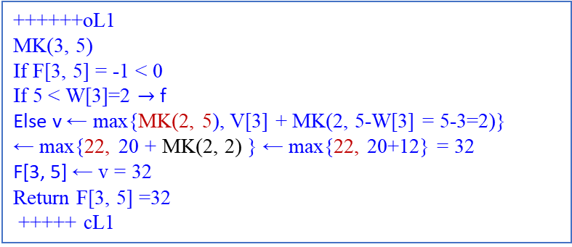
F(i, j) = Max{ F( i - 1, j), v_{i} + F( i -1, j - w_{i} ) } if j - w_{i} ≥ 0.
F( i - 1, j), if j - w_{i} < 0.
Algorithm MFKnapsack(i, j)
if F[i, j] < 0 {
if j < Weights[ i ]
value ← MFKnapsack(i -1, j)
else
value ← max{ MFKnapsack(i -1, j),
Value[ i ] + MFKnapsack(i -1, j – Weights[ i ]) };
F[i, j] ← value; }
return F[i, j];
initialization | capacity j
 | i | 0 | 1 | 2 | 3 | 4 | 5
 | 0 | 0 | 0 | 0 | 0 | 0 | 0
w₁ =2, v₁ = 12 | 1 | 0 | 0₃ | 12₃ | -1 | 12₃ | 12₃
w₂ =1, v₂ = 10 | 2 | 0 | -1 | 12₂ | -1 | -1 | 22₂
w₃ =3, v₃ = 20 | 3 | 0 | -1 | -1 | -1 | -1 | 32₁
w₄ =2, v₄ = 15 | 4 | 0 | -1 | -1 | -1 | -1 | -1₀
-------------oL0
MK(4, 5)
If F[4, 5] = -1 < 0
If 5 < W[4] = 2 $→$ f
Else v ← max{MK(3, 5), V[4] + MK[3, 5-W[4] = 5-2=3]}
++++++oL1
MK(3, 5)
If F[3, 5] = -1 < 0
If 5 < W[3]=2 $→$ f
Else v ← max{MK(2, 5), V[3] + MK[2, 5-W[3] = 5-3=2]} ← max{22, 20 + MK(2, 2) }
======= oL2
MK(2, 5) = 22
======= cL2
F[3, 5] ← v
Return F[3, 5]
+++++ cL1
F[4, 5] ← v
Return F[4, 5]
-----------cL0
++++++oL1
MK(3, 5)
If F[3, 5] = -1 < 0
If 5 < W[3]=2 $→$ f
Else v ← max{MK(2, 5), V[3] + MK(2, 5-W[3] = 5-3=2)}
← max{22, 20 + MK(2, 2) } ← max{22, 20+12} = 32
F[3, 5] ← v = 32
Return F[3, 5] =32
+++++ cL1

Slide 29


F(i, j) = Max{ F( i - 1, j), v_{i} + F( i -1, j - w_{i} ) } if j - w_{i} ≥ 0.
F( i - 1, j), if j - w_{i} < 0.
Algorithm MFKnapsack(i, j)
if F[i, j] < 0 {
if j < Weights[ i ]
value ← MFKnapsack(i -1, j)
else
value ← max{ MFKnapsack(i -1, j),
Value[ i ] + MFKnapsack(i -1, j – Weights[ i ]) };
F[i, j] ← value; }
return F[i, j];
initialization | capacity j
 | i | 0 | 1 | 2 | 3 | 4 | 5
 | 0 | 0 | 0 | 0 | 0 | 0 | 0
w₁ =2, v₁ = 12 | 1 | 0 | 0₃ | 12₃ | -1₃ | 12₃ | 12₃
w₂ =1, v₂ = 10 | 2 | 0 | -1 | 12₂ | -1₂ | -1 | 22₂
w₃ =3, v₃ = 20 | 3 | 0 | -1 | -1 | -1₁ | -1 | 32₁
w₄ =2, v₄ = 15 | 4 | 0 | -1 | -1 | -1 | -1 | -1₀
++++++oL1
MK(3, 3)
If F[3, 3] = -1 < 0
If 3 < W[3]=3 $→$ f
Else v ← max{MK(2, 3), V[3] + MK(2, 3-W[3] = 3-3=0)}
← max{MK(2, 3), 20 + MK(2, 0)} ← max{MK(2, 3), 20+0}
=========oL2
MK(2, 3)
If 3 < W[2]=1 $→$ f
Else v ← max{MK(1, 3), V[2] + MK(1, 3-W[2] = 3-1=2)}
← max{MK(1, 3), V[2] + MK(1, 2)}← max{MK(1, 3), 10 + 12}
+++++++++oL2
MK(1, 3)
+++++++++cL2
F[2, 3] ← v
Return F[2, 3]
=========cL2
F[3, 3] ← v
Return F[3, 3]
+++++ cL1
-------------oL0
MK(4, 5)
If F[4, 5] = -1 < 0
If 5 < W[4] = 2 $→$ f
Else v ← max{MK(3, 5), V[4] + MK[3, 5-W[4] = 5-2=3]}
← max{MK(3, 5), 15 + MK[3, 3]}
++++++oL1
MK(3, 5) Return F[3, 5] = 32
+++++ cL1
++++++oL1
MK(3,3)
++++++cL1
F[4, 5] ← v
Return F[4, 5]
-----------cL0

Slide 30

F(i, j) = Max{ F( i - 1, j), v_{i} + F( i -1, j - w_{i} ) } if j - w_{i} ≥ 0.
F( i - 1, j), if j - w_{i} < 0.
Algorithm MFKnapsack(i, j)
if F[i, j] < 0 {
if j < Weights[ i ]
value ← MFKnapsack(i -1, j)
else
value ← max{ MFKnapsack(i -1, j),
Value[ i ] + MFKnapsack(i -1, j – Weights[ i ]) };
F[i, j] ← value; }
return F[i, j];
initialization | capacity j
 | i | 0 | 1 | 2 | 3 | 4 | 5
 | 0 | 0 | 0 | 0 | 0 | 0 | 0
w₁ =2, v₁ = 12 | 1 | 0 | 0₃ | 12₃ | 12₃ | 12₃ | 12₃
w₂ =1, v₂ = 10 | 2 | 0 | -1 | 12₂ | -1₂ | -1 | 22₂
w₃ =3, v₃ = 20 | 3 | 0 | -1 | -1 | -1₁ | -1 | 32₁
w₄ =2, v₄ = 15 | 4 | 0 | -1 | -1 | -1 | -1 | -1₀
++++++oL1
MK(3, 3)
If F[3, 3] = -1 < 0
If 3 < W[3]=3 $→$ f
Else v ← max{MK(2, 3), V[3] + MK(2, 3-W[3] = 3-3=0)}
← max{MK(2, 3), 20 + MK(2, 0)} ← max{MK(2, 3), 20+0}
=========oL2
MK(2, 3)
If 3 < W[2]=1 $→$ f
Else v ← max{MK(1, 3), V[2] + MK(1, 3-W[2] = 3-1=2)}
← max{MK(1, 3), V[2] + MK(1, 2)}← max{MK(1, 3), 10 + 12}
+++++++++oL3
MK(1, 3)
If 3 < W[1]=2 $→$ f
Else v ← max{MK(0, 3), V[1] + MK(0, 3-W[1] = 3-2=1)}
← max{0, 12 + MK(0, 1)}= 12
F[1, 3] = 12; return F[1, 3] = 12
+++++++++cL3
F[2, 3] ← v
Return F[2, 3]
=========cL2
F[3, 3] ← v
Return F[3, 3]
+++++ cL1
-------------oL0
MK(4, 5)
If F[4, 5] = -1 < 0
If 5 < W[4] = 2 $→$ f
Else v ← max{MK(3, 5), V[4] + MK[3, 5-W[4] = 5-2=3]}
← max{MK(3, 5), 15 + MK[3, 3]}
++++++oL1
MK(3, 5) Return F[3, 5] = 32
+++++ cL1
++++++oL1
MK(3,3)
++++++cL1
F[4, 5] ← v
Return F[4, 5]
-----------cL0

Slide 31

F(i, j) = Max{ F( i - 1, j), v_{i} + F( i -1, j - w_{i} ) } if j - w_{i} ≥ 0.
F( i - 1, j), if j - w_{i} < 0.
Algorithm MFKnapsack(i, j)
if F[i, j] < 0 {
if j < Weights[ i ]
value ← MFKnapsack(i -1, j)
else
value ← max{ MFKnapsack(i -1, j),
Value[ i ] + MFKnapsack(i -1, j – Weights[ i ]) };
F[i, j] ← value; }
return F[i, j];
initialization | capacity j
 | i | 0 | 1 | 2 | 3 | 4 | 5
 | 0 | 0 | 0 | 0 | 0 | 0 | 0
w₁ =2, v₁ = 12 | 1 | 0 | 0₃ | 12₃ | 12₃ | 12₃ | 12₃
w₂ =1, v₂ = 10 | 2 | 0 | -1 | 12₂ | 22₂ | -1 | 22₂
w₃ =3, v₃ = 20 | 3 | 0 | -1 | -1 | -1₁ | -1 | 32₁
w₄ =2, v₄ = 15 | 4 | 0 | -1 | -1 | -1 | -1 | -1₀
++++++oL1
MK(3, 3)
If F[3, 3] = -1 < 0
If 3 < W[3]=3 $→$ f
Else v ← max{MK(2, 3), V[3] + MK(2, 3-W[3] = 3-3=0)}
← max{MK(2, 3), 20 + MK(2, 0)} ← max{MK(2, 3), 20+0}
=========oL2
MK(2, 3)
If 3 < W[2]=1 $→$ f
Else v ← max{MK(1, 3), V[2] + MK(1, 3-W[2] = 3-1=2)}
← max{MK(1, 3), V[2] + MK(1, 2)}← max{MK(1, 3), 10 + 12}
← max{12, 10 + 12} = 22
F[2, 3] = 22
Return F[2, 3] = 22
+++++++++oL3
MK(1, 3) return F[1, 3] = 12
+++++++++cL3
F[2, 3] ← v
Return F[2, 3]
=========cL2
F[3, 3] ← v
Return F[3, 3]
+++++ cL1
-------------oL0
MK(4, 5)
If F[4, 5] = -1 < 0
If 5 < W[4] = 2 $→$ f
Else v ← max{MK(3, 5), V[4] + MK[3, 5-W[4] = 5-2=3]}
← max{MK(3, 5), 15 + MK[3, 3]}
++++++oL1
MK(3, 5) Return F[3, 5] = 32
+++++ cL1
++++++oL1
MK(3,3)
++++++cL1
F[4, 5] ← v
Return F[4, 5]
-----------cL0

Slide 32


F(i, j) = Max{ F( i - 1, j), v_{i} + F( i -1, j - w_{i} ) } if j - w_{i} ≥ 0.
F( i - 1, j), if j - w_{i} < 0.
Algorithm MFKnapsack(i, j)
if F[i, j] < 0 {
if j < Weights[ i ]
value ← MFKnapsack(i -1, j)
else
value ← max{ MFKnapsack(i -1, j),
Value[ i ] + MFKnapsack(i -1, j – Weights[ i ]) };
F[i, j] ← value; }
return F[i, j];
initialization | capacity j
 | i | 0 | 1 | 2 | 3 | 4 | 5
 | 0 | 0 | 0 | 0 | 0 | 0 | 0
w₁ =2, v₁ = 12 | 1 | 0 | 0₃ | 12₃ | 12₃ | 12₃ | 12₃
w₂ =1, v₂ = 10 | 2 | 0 | -1 | 12₂ | 22₂ | -1 | 22₂
w₃ =3, v₃ = 20 | 3 | 0 | -1 | -1 | 22₁ | -1 | 32₁
w₄ =2, v₄ = 15 | 4 | 0 | -1 | -1 | -1 | -1 | -1₀
++++++oL1
MK(3, 3)
If F[3, 3] = -1 < 0
If 3 < W[3]=3 $→$ f
Else v ← max{MK(2, 3), V[3] + MK(2, 3-W[3] = 3-3=0)}
← max{MK(2, 3), 20 + MK(2, 0)} ← max{MK(2, 3), 20+0}
← max{22, 20+0}
F[3, 3] = 22
Return F[3, 3] = 22
=========oL2
MK(2, 3)
Return F[2, 3] = 22
+++++++++oL3
MK(1, 3) return F[1, 3] = 12
+++++++++cL3
F[2, 3] ← v
Return F[2, 3]
=========cL2
F[3, 3] ← v
Return F[3, 3]
+++++ cL1
-------------oL0
MK(4, 5)
If F[4, 5] = -1 < 0
If 5 < W[4] = 2 $→$ f
Else v ← max{MK(3, 5), V[4] + MK[3, 5-W[4] = 5-2=3]}
← max{MK(3, 5), 15 + MK[3, 3]}
++++++oL1
MK(3, 5) Return F[3, 5] = 32
+++++ cL1
++++++oL1
MK(3,3) = 22
++++++cL1
F[4, 5] ← v
Return F[4, 5]
-----------cL0

Slide 33

F(i, j) = Max{ F( i - 1, j), v_{i} + F( i -1, j - w_{i} ) } if j - w_{i} ≥ 0.
F( i - 1, j), if j - w_{i} < 0.
Algorithm MFKnapsack(i, j)
if F[i, j] < 0 {
if j < Weights[ i ]
value ← MFKnapsack(i -1, j)
else
value ← max{ MFKnapsack(i -1, j),
Value[ i ] + MFKnapsack(i -1, j – Weights[ i ]) };
F[i, j] ← value; }
return F[i, j];
initialization | capacity j
 | i | 0 | 1 | 2 | 3 | 4 | 5
 | 0 | 0 | 0 | 0 | 0 | 0 | 0
w₁ =2, v₁ = 12 | 1 | 0 | 0₃ | 12₃ | 12₃ | 12₃ | 12₃
w₂ =1, v₂ = 10 | 2 | 0 | -1 | 12₂ | 22₂ | -1 | 22₂
w₃ =3, v₃ = 20 | 3 | 0 | -1 | -1 | 22₁ | -1 | 32₁
w₄ =2, v₄ = 15 | 4 | 0 | -1 | -1 | -1 | -1 | 37₀
-------------oL0
MK(4, 5)
If F[4, 5] = -1 < 0
If 5 < W[4] = 2 $→$ f
Else v ← max{MK(3, 5), V[4] + MK[3, 5-W[4] = 5-2=3]}
← max{MK(3, 5), 15 + MK[3, 3]}
← max{MK(32, 15 + 22} ← max{MK(32, 37} = 37
F[4, 5] ← 37
Return F[4, 5] ← 37
++++++oL1
MK(3, 5) Return F[3, 5] = 32
+++++ cL1
++++++oL1
MK(3,3) = 22
++++++cL1
F[4, 5] ← v
Return F[4, 5]
-----------cL0
++++++oL1
MK(3, 3) Return F[3, 3] = 22
=========oL2
MK(2, 3)
Return F[2, 3] = 22
+++++++++oL3
MK(1, 3) return F[1, 3] = 12
+++++++++cL3
F[2, 3] ← v
Return F[2, 3]
=========cL2
F[3, 3] ← v
Return F[3, 3]
+++++ cL1

Slide 34
Example 2: Apply the memory function method (MF) to the instance considered in Example 1. The table in Figure 8.6 gives the results. This MF method computes only 11 entries of nontrivial values, whereas the version in Example 1 computes nW = 4 *5 = 20 entries of nontrivial values; (i.e., not those in row 0 or in column 0). Just one nontrivial entry, F(1, 2), is retrieved rather than being recomputed. For larger instances, the proportion of such entries can be significantly larger.
 | capacity j
 | i | 0 | 1 | 2 | 3 | 4 | 5
 | 0 | 0 | 0 | 0 | 0 | 0 | 0
w₁ =2, v₁ = 12 | 1 | 0 | 0 | 12 | 12 | 12 | 12
w₂ =1, v₂ = 10 | 2 | 0 | - | 12 | 22 | - | 22
w₃ =3, v₃ = 20 | 3 | 0 | - | - | 22 | - | 32
w₄ =2, v₄ = 15 | 4 | 0 | - | - | - | - | 37
Figure 8.6 Example of solving an instance of the knapsack problem by the memory function algorithm

Slide 35
 | F(i, 0) = 0 | capacity j
 | i | 0 | 1 | 2 | 3 | 4 | 5
F(0 , j) = 0 | 0 | 0 | 0 | 0 | 0 | 0 | 0
w₁ = 2, v₁ = 12 | 1 | 0 | 0 | 12 | 12 | 12 | 12
w₂ = 1, v₂ = 10 | 2 | 0 | 10 | 12 | 22 | 22 | 22
w₃ = 3, v₃ = 20 | 3 | 0 | 10 | 12 | 22 | 30 | 32
w₄ = 2, v₄ = 15 | 4 | 0 | 10 | 15 | 25 | 30 | 37
F(i, j) = Max{ F( i – 1, j), v_{i} + F( i -1, j - w_{i} ) } if j - w_{i} ≥ 0.
F(i -1, j), if j - w_{i} < 0
 | capacity j
 | i | 0 | 1 | 2 | 3 | 4 | 5
 | 0 | 0 | 0 | 0 | 0 | 0 | 0
w₁ =2, v₁ = 12 | 1 | 0 | 0 | 12 | 12 | 12 | 12
w₂ =1, v₂ = 10 | 2 | 0 | - | 12 | 22 | - | 22
w₃ =3, v₃ = 20 | 3 | 0 | - | - | 22 | - | 32
w₄ =2, v₄ = 15 | 4 | 0 | - | - | - | - | 37

Slide 36
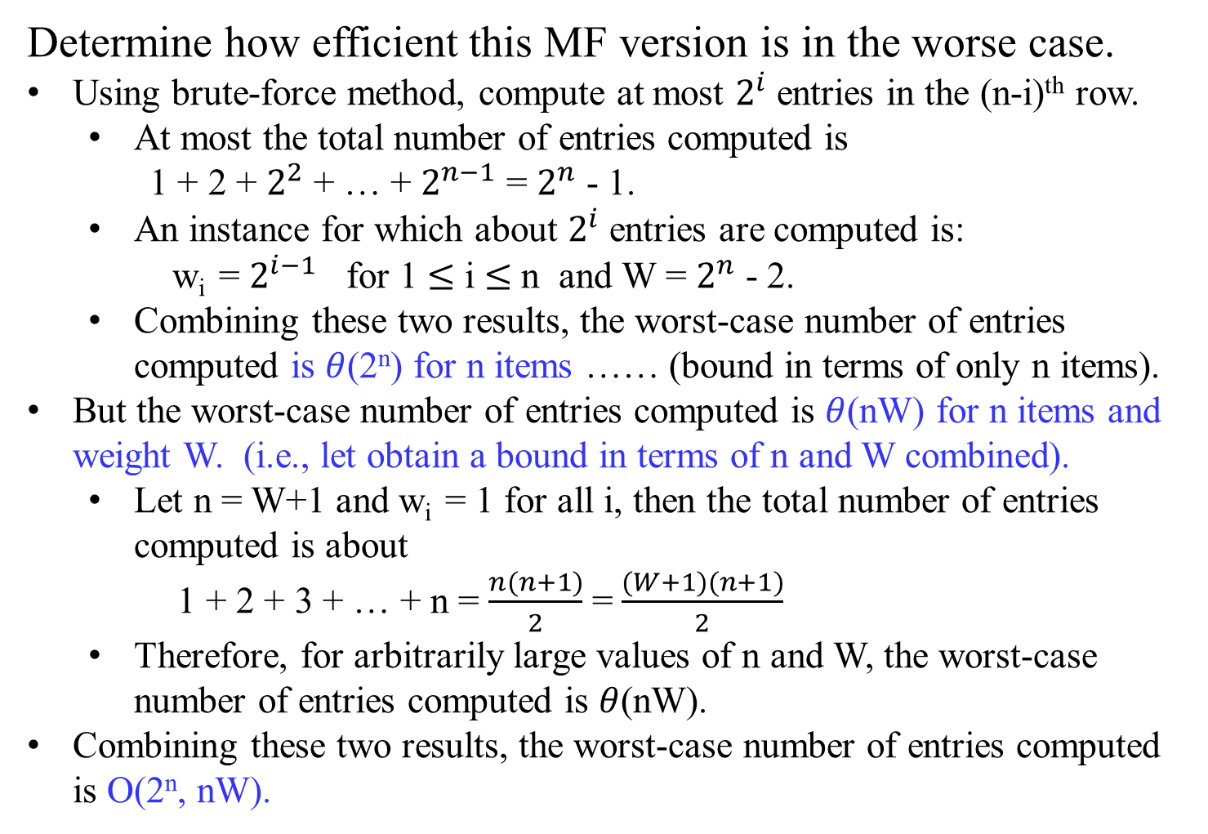
Determine how efficient this MF version is in the worse case.
Using brute-force method, compute at most $2^{i}$ entries in the (n-i)^{th} row.
At most the total number of entries computed is
1 + 2 + $2^{2}$ + … + $2^{n−1}$ = $2^{n}$ - 1.
An instance for which about $2^{i}$ entries are computed is:
w_{i} = $2^{i−1}$ for 1 $≤$ i $≤$ n and W = $2^{n}$ - 2.
Combining these two results, the worst-case number of entries computed is $θ$(2^{n}) for n items …… (bound in terms of only n items).
But the worst-case number of entries computed is $θ$(nW) for n items and weight W. (i.e., let obtain a bound in terms of n and W combined).
Let n = W+1 and w_{i} = 1 for all i, then the total number of entries computed is about
1 + 2 + 3 + … + n = $\frac{n(n+1)}{2}$ = $\frac{(W+1)(n+1)}{2}$
Therefore, for arbitrarily large values of n and W, the worst-case number of entries computed is $θ$(nW).
Combining these two results, the worst-case number of entries computed is O(2^{n}, nW).

Slide 37

Memory Functions
A naïve recursive solution is inefficient
it solves the same subproblems repeatedly.
Example: Fibonnaci Numbers … an exponential-time solution
Instead,
for each subproblem, solve it only once, and saves its solution.
Look up this subproblem’s solution again when it is needed.
…

Slide 38
Dynamic programming uses additional memory to save computation time:
an example of a time-memory trade-off.
Transforms an exponential-time solution into a polynomial-time solution, if memory function were used.
A dynamic-programming approach runs in polynomial time
when the number of distinct subproblems involved is polynomial in the input size and
solve each such subproblem in polynomial time.
…

Slide 39
Two equivalent ways for implementing a dynamic programming approach:
The first approach is top-down with memorization.
Write the procedure recursively, and then modify it to save the result of each subproblem (in an array or a hash table).
The recursive procedure
first checks whether “this” subproblem” has previously solved.
If so, returns the save value of its previous computation.
if not, the procedure computes this subproblem and then saves its value.
We say that the recursive procedure has been memorized.
It saves what results it has computed previously.

Slide 40
The second approach is the bottom-up method with memorization.
In principle, solve each subproblem only once, after all its prerequisite and smaller subproblems were solved (computed) and saved.
This approach depends on the “size” of a subproblem: solving any particular subproblem depends only on solving “smaller” subproblems.
Sort the subproblems by size and solve (and saved) them in size order, smallest first.
Solve any subproblem which depends on the solutions of smaller subproblems which were computed and saved.

Slide 41

The bottom-up method with memorization is
an alternative approach to dynamic programming that offers the efficiency of the bottom-up dynamic programming approach while maintaining a top-down strategy.
The idea is to memorize the natural, but inefficient, recursive algorithm.
Apply the bottom-up approach to maintaining a table with subproblem solutions, but use the recursive algorithm for filling in the table.
A memorized recursive algorithm maintains an entry in a table for the solution to each subproblem.
Each table entry initially contains a special value to indicate that the entry has yet to be filled in.
When the subproblem is first encountered as the recursive algorithm unfolds, its solution is computed and then stored in the table.
Each subsequent time when this subproblem is encountered, simply look up its stored value from the table and return it.

Slide 42
These two approaches yield algorithms with the same asymptotic running time, except in unusual circumstance where
the top-down approach does not actually recurse to examine all possible subproblems.
The bottom-up approach often has much better constant factors, since it has less overhead for procedure calls. [Cohen et al.]

Slide 43

A bottom-up dynamic-programming algorithm usually outperforms the corresponding top-down memorized algorithm by a constant factor, if all subproblems must be solved at least once.
This is because the bottom-up algorithm has
no overhead for recursion and
less overhead for maintaining the table accesses in the dynamic-programming algorithm
to reduce time or space requirements even further.

Slide 44
Alternatively if some subproblems in the subproblem space need not be solved at all, the memorized solution (top-down memorized algorithm) has the advantage of solving only those subproblems that are definitely required.
Using memory functions, a method solves a given problem in the top-down manner but, in addition, maintains a table of the kind that would have been used by a bottom-up dynamic programming algorithm.

Slide 45
Initially, all the table’s entries are initialized with a special “null” symbol to indicate that they have not yet been calculated.
Thereafter, whenever a new value needs to be calculated, the method checks the corresponding entry in the table first:
if this entry is not “null”, it is simply retrieved from the table ;
otherwise, it is computed by the recursive call whose result is then recorded in the table.

Slide 46
The following algorithm implements this idea for the knapsack problem. After initializing the table, the recursive function needs to be called with i = n (the number of items) and j = W (the knapsack capacity).

Slide 47
Algorithm MFKnapsack(i, j)
//Implements the memory function method for the knapsack problem
Input: A nonnegative integer i indicating the number of the first items
being considered and a nonnegative integer j indicating the
knapsack capacity.
Output: The value of an optimal feasible subset of the first i items
//Note : Uses as global variables input arrays Weights[1 .. n], Values[1 .. n],
// and table F[0 .. n, 0 .. W] whose entries are initialize with -1’s except
// for row 0 and column 0 initialized with 0’s
if F[i, j] < 0 {
if j < Weights[ i ]
value ← MFKnapsack(i -1, j)
else
value ← max{ MFKnapsack(i -1, j),
Value[ i ] + MFKnapsack(i -1, j – Weights[ i ]) };
F[i, j] ← value; }
return F[i, j];

Slide 48
Example 2 Apply the memory function method to the instance considered in Example 1. The table in Figure 8.6 gives the results. Only 11 out of 20 nontrivial values (i.e., not those in row 0 or in column 0) have been computed. Just one nontrivial entry, F(1, 2), is retrieved rather than being recomputed. For larger instances, the proportion of such entries can be significantly larger.
 | capacity j
 | i | 0 | 1 | 2 | 3 | 4 | 5
 | 0 | 0 | 0 | 0 | 0 | 0 | 0
w₁ =2, v₁ = 12 | 1 | 0 | 0 | 12 | 12 | 12 | 12
w₂ =1, v₂ = 10 | 2 | 0 | - | 12 | 22 | 22 | 22
w₃ =3, v₃ = 20 | 3 | 0 | - | - | 22 | - | 32
w₄ =2, v₄ = 15 | 4 | 0 | - | - | - | - | 37
Figure 8.6 Example of solving an instance of the knapsack problem by the memory function algorithm

Slide 49
 | F(i, 0) = 0 | capacity j
 | i | 0 | 1 | 2 | 3 | 4 | 5
F(0 , j) = 0 | 0 | 0 | 0 | 0 | 0 | 0 | 0
w₁ = 2, v₁ = 12 | 1 | 0 | 0 | 12 | 12 | 12 | 12
w₂ = 1, v₂ = 10 | 2 | 0 | 10 | 12 | 22 | 22 | 22
w₃ = 3, v₃ = 20 | 3 | 0 | 10 | 12 | 22 | 30 | 32
w₄ = 2, v₄ = 15 | 4 | 0 | 10 | 15 | 25 | 30 | 37
F(i, j) = Max{ F( i – 1, j), v_{i} + F( i -1, j - w_{i} ) } if j - w_{i} ≥ 0.
F(i -1, j), if j - w_{i} < 0
 | capacity j
 | i | 0 | 1 | 2 | 3 | 4 | 5
 | 0 | 0 | 0 | 0 | 0 | 0 | 0
w₁ =2, v₁ = 12 | 1 | 0 | 0 | 12 | 12 | 12 | 12
w₂ =1, v₂ = 10 | 2 | 0 | - | 12 | 22 | - | 22
w₃ =3, v₃ = 20 | 3 | 0 | - | - | 22 | - | 32
w₄ =2, v₄ = 15 | 4 | 0 | - | - | - | - | 37

Slide 50
In general, we cannot expect more than a constant-factor gain in using the memory function method for the knapsack problem, because its time efficiency class is the same as that of the bottom-up algorithm (why?).
A more significant improvement can be expected for dynamic programming algorithms in which a computation of one value takes more than constant time.
A memory function algorithm may be less space-efficient than a space efficient version of a bottom-up algorithm.

Slide 51
Chapter 06_07 Dynamic Programming The Traveling Salesperson Problem

